Slide 1

Micro-ROS ROS-Industrial Spring Workshop May 7th 2018 Dr.-Ing. Ingo Lütkebohle, Bosch Corporate Research
Partially supported by EU grant 780785

Slide 2
“In the future it should be possible to implement the ROS protocol directly on the devices embedded system”
ROS2 Design Wiki “Stories”

Slide 3
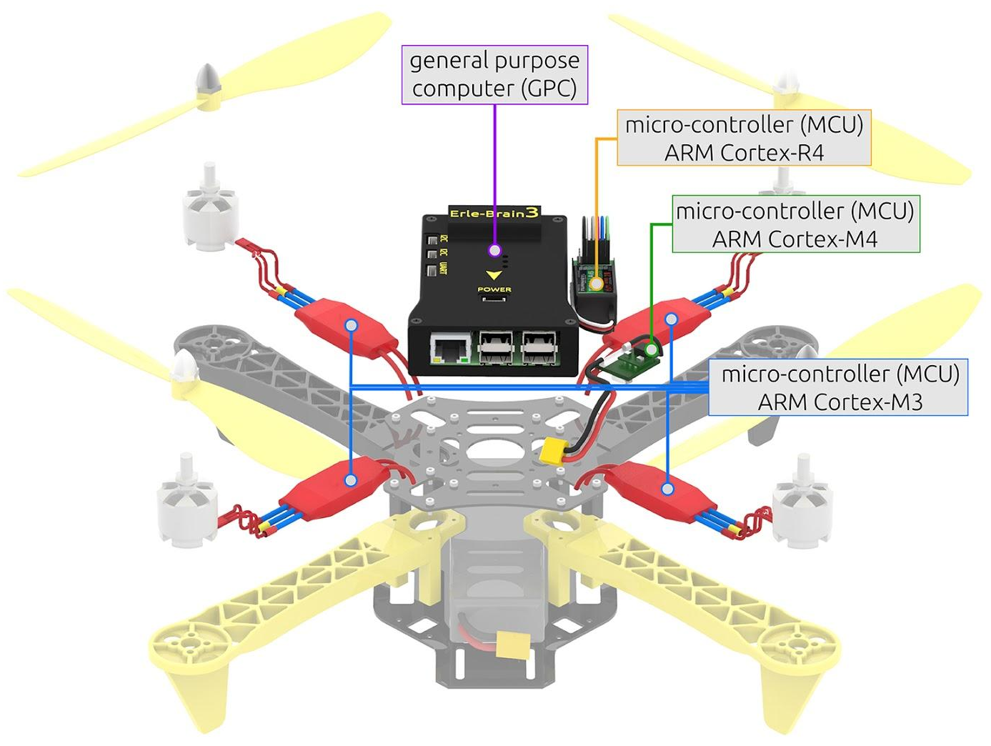
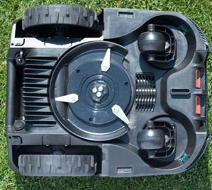
Robots are networks of devices
Micro-ROS
Embedded
ROS
Wire Sensor
Linux
Nav GPC
Micro-Processor
Motor Control MCU
Serial/Bus
Safety MCU
Comm MCU
Firmware
Micro-Controller
Wire Sensor
Sensor/Actor
Image source: Bosch PowerTools GmbH, All rights reserved
Focus Today
Image source: Erle Robotics, taken from OFERA proposal.

Slide 4





Open Framework for Embedded Robot Applications (OFERA)
Micro-ROS
OFERA will extend ROS2 to allow its use in MCUs
https://ofera.eu/
The OFERA project is funded by the European Union‘s Horizon 2020 research and innovation programme under grant agreement No 780785
Application component
Application component
…
rcl
Predictable execution (scheduling)
Lifecycle and system modes
Embedded transform library
FIWARE
Interop.
ROS
Interop.
rmw
Benchmarking
rmw_microxrcedss
RTOS abstractions
RTOS
Additional device drivers
Scheduler extensions
Microcontroller platform

Slide 5
Situation
Micro-ROS
ROS+Linux is a powerful combo
Excellent libraries for perception, planning, networking, etc
Unified developer eco-system: One kernel, most devices
It’s what we all have on our desks
But…
Issue 1: Hardware access
Issue 2: Hard, low-latency RT
Issue 3: Power saving
Issue 4: Safety

Slide 6




Real-Time Operating Systems (RTOSs)
Micro-ROS
RTOSs are optimized for real-time performance
In OFERA, we’re using NuttX as the default
POSIX-style API makes porting easy
Other interesting choices include RIOT, FreeRTOS, Zephyr, etc
RTOS diversity is an issue
Hardware diversity is an even bigger issue
Something unifying would go a long way…

Slide 7
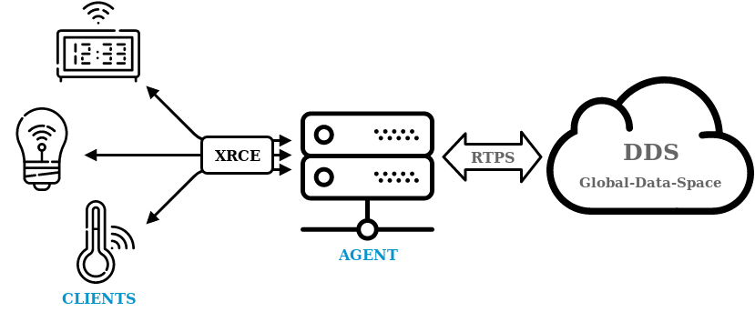
New DDS-XRCE Standard
Micro-ROS
DDS-XRCE for eXtremely Resource Constrained Environments … brings DDS on MCUs
Client-server approach
Power-saving
Disconnected use
I’m assuming you heard a lot about it yesterday
Open-source at github.com/eProsima/Micro-XRCE-DDS

Slide 8
Side-by-Side Comparison
Micro-ROS
 | ROS2 | Micro-ROS
Hardware | X86, ARM Cortex-A, … | ARM Cortex-M, ….
Resources | >512MB RAM, >8G Disk | ~100K RAM, ~1MB Flash
Communications | GBit/s, Ethernet, 802.11 WiFi | Serial, WPAN – 250k to 1MBit/s
Operating System | Linux, Windows, MacOS | RTOS (NuttX by default)
Middleware | DDS variant (by default) | XRCE-DDS (by default)
Middleware Abstraction | RMW | RMW
Client Support Library | RCL | RCL
Execution Layer | RCLCPP / RCLPY / … | RCL + RCLCPP
Executors | Generic | Custom

Slide 9
Issue 1: Hardware access
Micro-ROS
Why not use Industrial PCs?
You’re always talking to some piece of firmware over a comm link
It usually doesn’t do exactly what you want
There’s latency
Driver implementation…
A multitude of serial protocols
Almost as bad for field buses
Often, important things (timing…) are not in the data-sheets
State management for external devices is a mess
→ We need to get into the firmware
ROS
Linux
Regular CPU
Serial/Bus
Firmware
Micro-Controller
Sensor/Actor

Slide 10
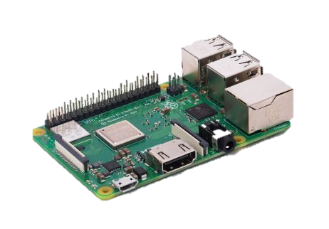
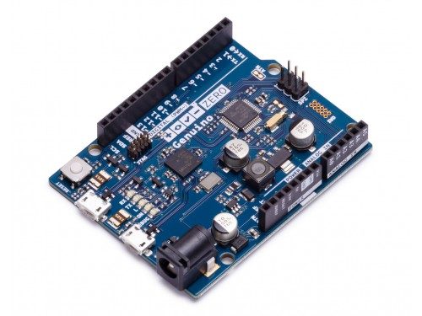
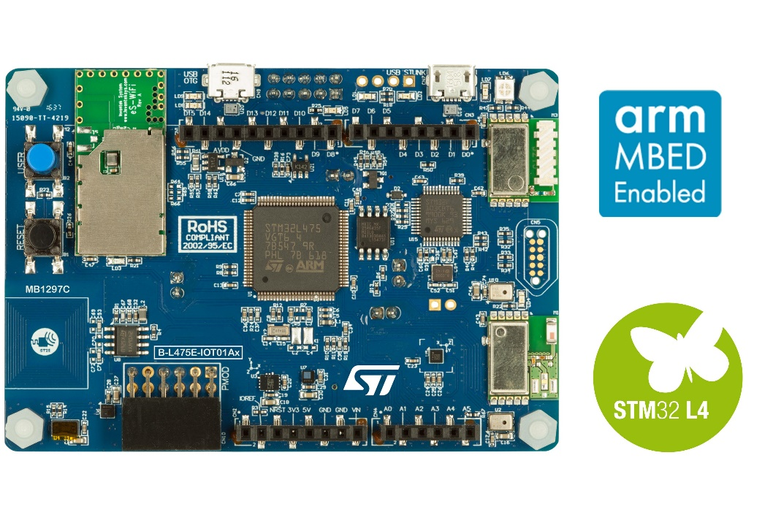
Hacker-friendly single-board computers
Micro-ROS
Cortex-A class
E.g., Raspberry Pi
512MB RAM, SD card storage
Reasonable set of I/O pins
WIFI, BT, Ethernet, USB
Linux capable
Cortex-M4 class
E.g., STM32 IoT Discovery
~128kB RAM, 1MB flash
Arduino-I/Os, PMOD
Low-power networks
Built-in sensors + I2C, SPI, etc
Arduino-class
8/32 bit MCU
4-16kB RAM
Bare-metal
Arduino I/Os
Huge shield ecosystem

Slide 11
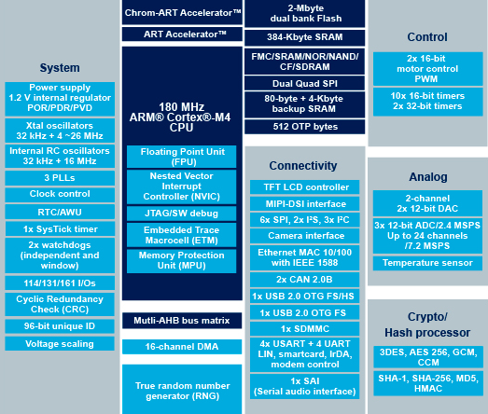
Micro-Controllers: Hardware Access
Micro-ROS
Micro-Controller, n: Chip that contains a processor and peripherals
analog/digital converters (ADC)
Quadrature decoders (QED)
PWM generators
Digital IOs (GPIO)
…
Buses with register support
CAN, UART, SPI, I²C,…
Register mapping for read/write
Much higher diversity and rate of evolution than general purpose CPUs
Image source: STMicro website, https://www.st.com/en/microcontrollers/stm32f479bi.html

Slide 12
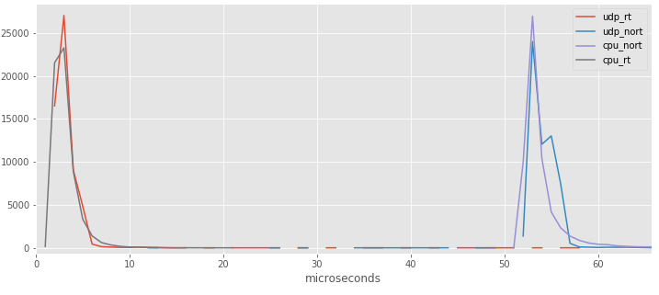
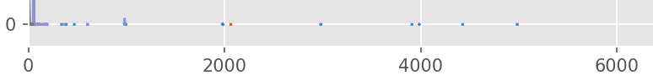
Issue 2: Status of RT on Linux
Micro-ROS
Linux scheduler has an RT class
On a high-end PC, it gets you down to ~5μs task activation time
But kernel processes can stall it
Outliers up to tens of milliseconds
Linux PREEMPT-RT Patch solves this
Can be difficult to integrate with other patches (e.g., BSP and proprietary drivers)
This is after more than a decade of work
μs

Slide 13
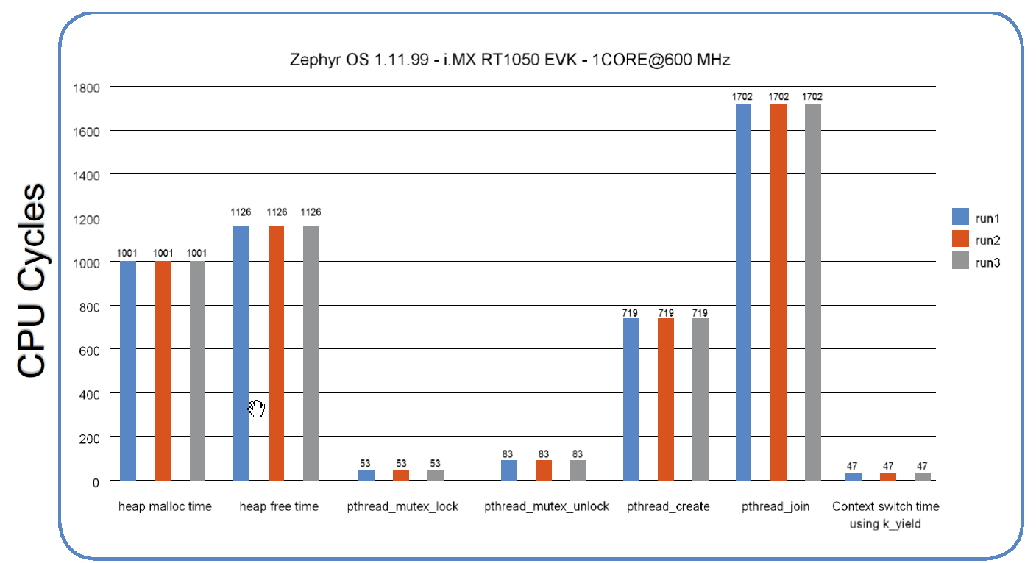
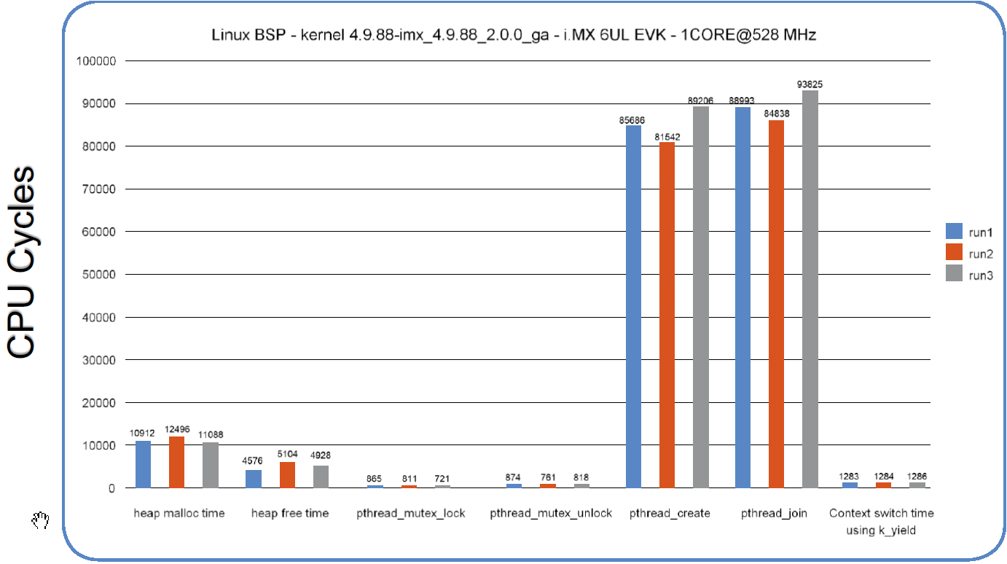
Example: Context Switch Time RTOS vs. Linux
Micro-ROS
cycles
cycles
Zephyr
Linux
Source: “PERFORMANCE ANALYSIS USING NXP’S I.MX RT1050 CROSSOVER PROCESSOR AND THE ZEPHYR™ OS”, MAUREEN HELM, LEOTESCU FLORIN, MARIUS CRISTIAN VLAD, NXP, 2018.
https://www.nxp.com/docs/en/training-reference-material/BENCHMARK-ZEPHYR-OS-PDF.pdf

Slide 14
NuttX, the „Tiny Linux“
Micro-ROS
RTOS with POSIX API
Released first in 2007 by Gregory Nutt
„Batteries included“
Shell
TCP/IP
Incl. DHCP, NTP
6LowPAN
C++ standard libs: libcxx or uclibc++
Many device drivers and BSPs
Focused mainly on ARM, ARC, Atmel
much more…
http://nuttx.org/
RTOS | POSIX? | libstdc++?
Zephyr | Threads, Time, IPC | No
ARM Mbed | No | No
FreeRTOS | Threads, Time | No
RIOT | Partial | ??

Slide 15
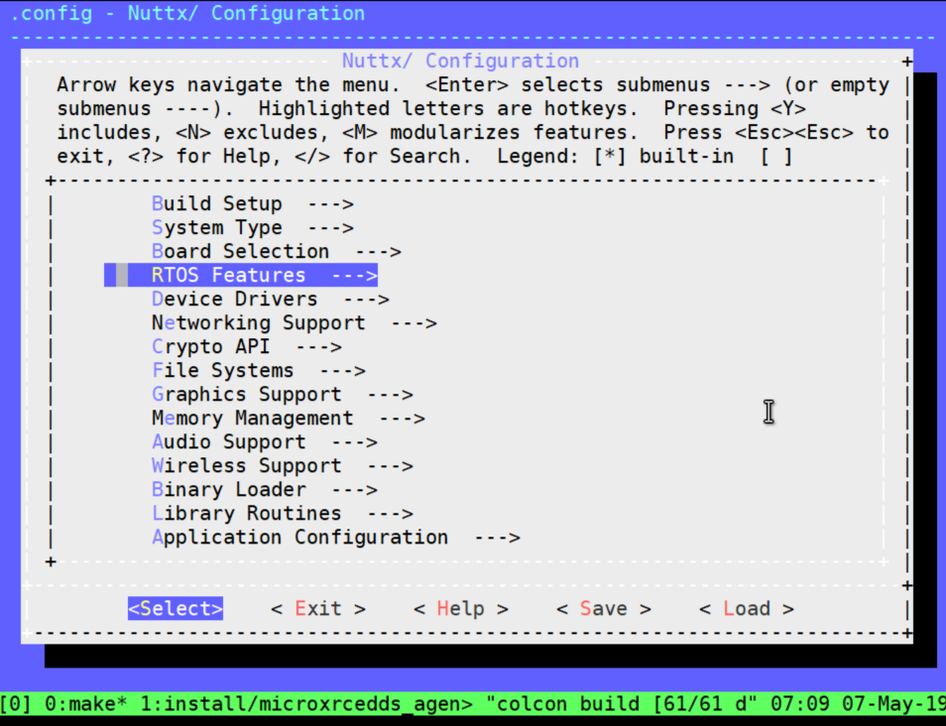
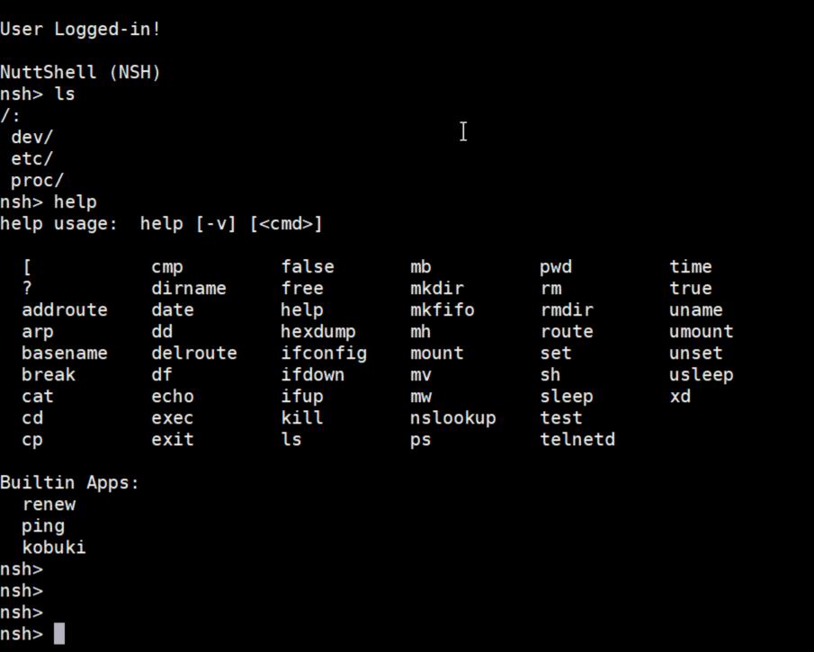
NuttX Demo
Micro-ROS

Slide 16
Issue 3: Power-saving
Micro-ROS
Power use is important in many embedded applications
Battery-powered sensors
Unmanned aerial vehicles
Standby operation
Linux SBC use 1-2 orders of magnitude more power (Sources: http://www.pidramble.com/wiki/benchmarks/power-consumption, https://learn.adafruit.com/embedded-linux-board-comparison/power-usage, OFERA measurements)
Device | Idle | Operational
Rpi A | ~150mA | ~180mA
Rpi 3 | ~350mA | 500-800mA
STM32L1 | ~3mA | ~10mA
STM32F4 | ~10mA | ~100mA

Slide 17
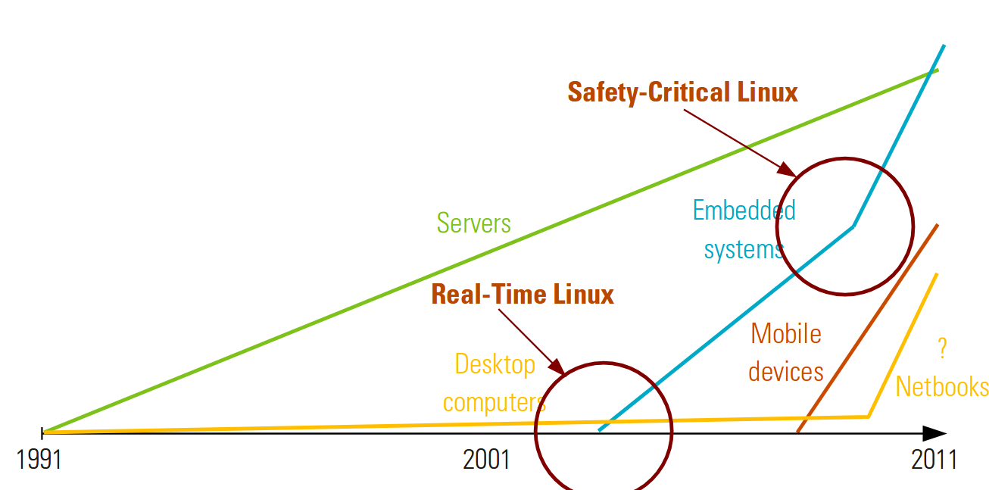
Issue 4: Safety
Micro-ROS
Being worked on since (at least) 2011
SIL2Linux
Project P
…
SIL2Linux
Target: Safety Integrity Level 2
Strips much of Linux, most notably many drivers
Going on for years, not clear what the outcome is
But do watch https://elisa.tech/ !
The highest SIL level is 4…
And then there’s the question of appropriate compute hardware
Image source: Carsten Emde, OSADL. Embedded World Presentation March 3rd 2011

Slide 18
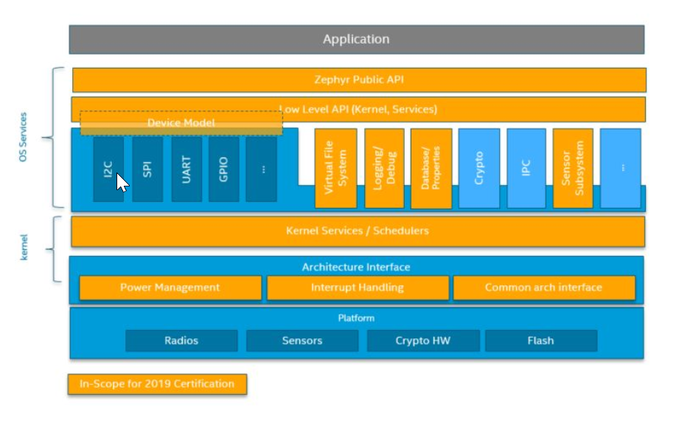
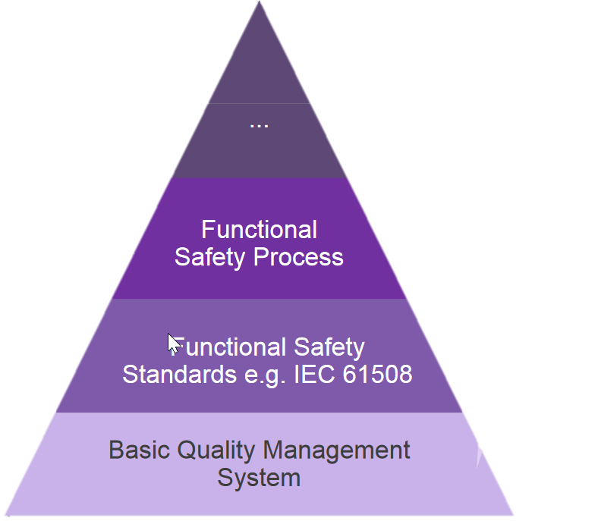
Open Source and Safety
Micro-ROS
Zephyr RTOS (a Linux Foundation project) attempts Safety Certification in 2019
Subset of whole OS
Orange boxes: In scope for 2019
Notably no drivers!
Based on existing work on security
Image source: https://events.linuxfoundation.org/wp-content/uploads/2018/07/OSLS-2019_-Zephyr-Project-.pdf

Slide 19
CURRENT STATUS

Slide 20
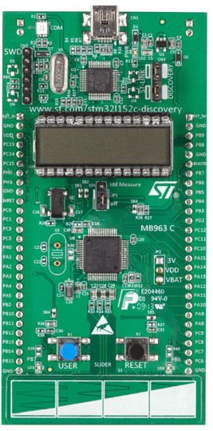
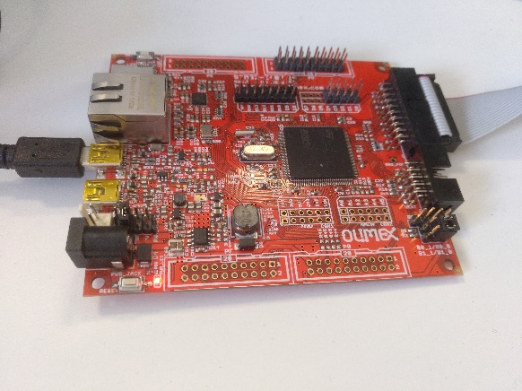
Target Devices
Micro-ROS
Device Classes
Low-end: MCUs starting at 32kB RAM with low-power consumption
E.g., STM32L1
Typical: Cortex-M4 devices with ~100kB RAM
E.g., STM32F4
Going below 32kB would likely require a different architectural approach and is not currently in scope
OFERA has two references boards with full OS support provided by partner Acutronic Link Robotics
STM32L1-DISCOVERY
OLIMEX STM32E407

Slide 21
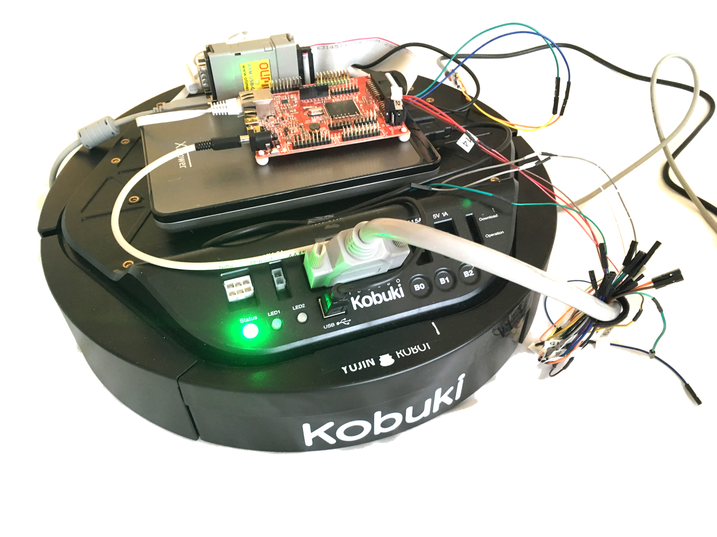
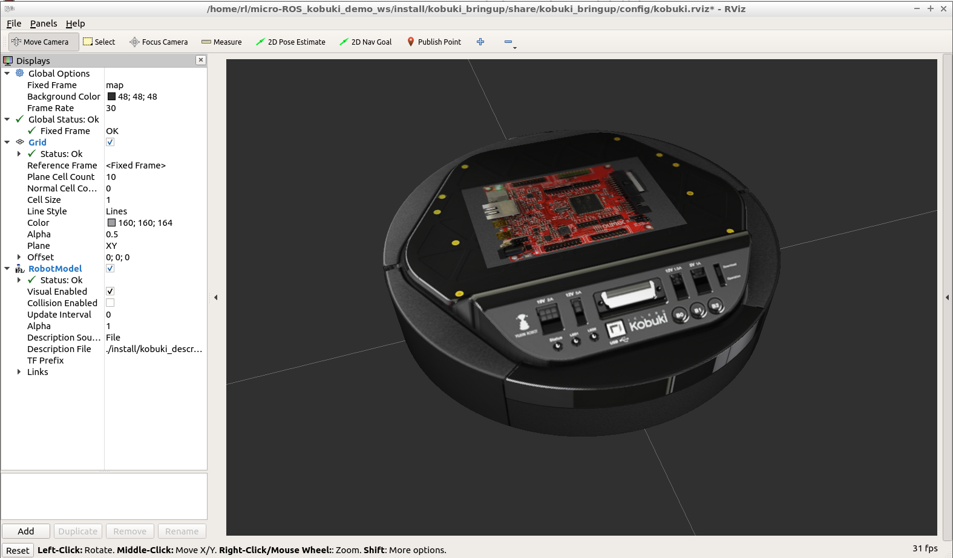

Turtlebot 2 Demo
Micro-ROS
ROS 2 (Crystal) running
- Visualization
- Keyboard control - odometry to TF
- DDS <-> DDS-XRCE agent
micro-ROS running
- thin_kobuki_driver
- DDS-XRCE client at less than 100 KB RAM
DDS-XRCE over UDP
Preliminary version at github.com/microROS/micro-ROS_kobuki_demo

Slide 22
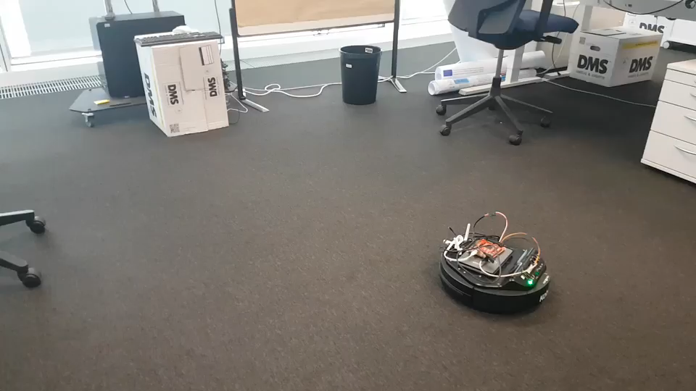
Turtlebot 2 Demo
Micro-ROS
Based on „thin kobuki“ driver
Converted to use rcl API
rclcpp wasn‘t ready at the time
Porting issues?
A few issues with C++ initialization

Slide 23
Upcoming work

Slide 24
Recap: Composable firmware
Micro-ROS
Nowadays, firmware provided by vendor
Unforeseen features? Bad luck…
Vision: Add new features to existing firmware
ROS2 way: Just add nodes
Challenge: Interference
Need to make sure existing stuff still works!
Micro-ROS Approach:
System Modes
Domain-specific scheduling, towards providing guarantees

Slide 25
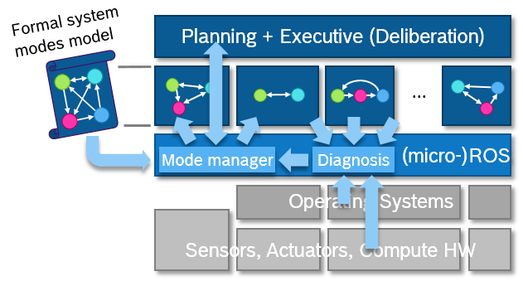
Towards explicit architecture
Micro-ROS
The OFERA project is funded by the European Union‘s Horizon 2020 research and innovation programme under grant agreement No 780785
14
CR/AEE1-Lange | 2019-03-29
© Robert Bosch GmbH 2016. All rights reserved, also regarding any disposal, exploitation, reproduction, editing, distribution, as well as in the event of applications for industrial property rights.

Slide 26
System Modes
Micro-ROS
Introduces (sub-)systems hierarchy to ROS 2
Abstraction for hierarchical configuration, called system modes
Mode manager manages consistent, system-wide configuration
See microros.github.io/system_modes/
Mode Manager
model file
.yaml
mode change
request
inference
(sub-)systems
observation
nodes
lifecycle events
parameters events
system
subsystem 01
subsystem 02
The OFERA project is funded by the European Union‘s Horizon 2020 research and innovation programme under grant agreement No 780785
15
CR/AEE1-Lange | 2019-03-29
© Robert Bosch GmbH 2016. All rights reserved, also regarding any disposal, exploitation, reproduction, editing, distribution, as well as in the event of applications for industrial property rights.

Slide 27
Predictable Execution
Micro-ROS
First approach enables multiple executors per operating system process
Executors can be configured individually using standard scheduling mechanisms
Open-sourced prototype for ROS 2
See microros.github.io/real-time_executor/
Drive-Base node
onEmergencyStopMsg onCmdVel
publishWheelTicks reportDiagnosticsData
Other node
…
…
Executor
Executor
Executor
OS Scheduler
The OFERA project is funded by the European Union‘s Horizon 2020 research and innovation programme under grant agreement No 780785
16
CR/AEE1-Lange | 2019-03-29
© Robert Bosch GmbH 2016. All rights reserved, also regarding any disposal, exploitation, reproduction, editing, distribution, as well as in the event of applications for industrial property rights.

Slide 28
Domain-specific scheduling
Micro-ROS
Current real-time schedulers typically use priorities
Not composable!
Not domain-appropriate
Micro-ROS Approach: Domain-specific schedulers
E.g., stage-based approach with „Sense-Plan-Act“
Or more stages…
Assign callbacks to stage using callback groups
Derive within-group order from communication links
Provide „budgets“ by group
Sense
Laser
IMU
Plan
Obstacle Avoidance
Act
Velocity control
Report progress
Wheel Encoders
Model
Sensior Fusion
Mapping
Path Planning
Laser Driver
Read Scan
Diagnostics
Obstacle Avoidance
Update Map
Drive Base
Read Encoders
Speed Control
Scan Covariance
Compute Velocity

Slide 29
Building micro-ROS…
Micro-ROS
Challenge: RTOS defines toolchain and system headers
What‘s the build order?
Currently: ROS2 workspace built as part of NuttX build
Pro: Handles toolchain (cross-compiling, etc.)
Con: Time consuming
Con: Workspace is not aware of being a micro-ROS target
Current work: Build everything using colcon
NuttX vendor package to configure and build NuttX
Colcon configuration to configure toolchain

Slide 30
Building an ecosystem
Micro-ROS
Does this mean that every ROS developer can now start using MCUs?
Well…

Slide 31
Further information
ROS 2 Embedded
microROS organization at GitHub
https://micro-ros.github.io/
https://github.com/micro-ROS/
OFERA website: https://ofera.eu/
ROS 2 Embedded Design Page
Currently at https://github.com/ros2/design/pull/197
After merge: http://design.ros2.org/articles/embedded.html

Slide 32
Thank you

